Slide 1
CS 152 Computer Architecture and Engineering CS252 Graduate Computer Architecture Lecture 8 – Address Translation
Krste Asanovic
Electrical Engineering and Computer Sciences
University of California at Berkeley
http://www.eecs.berkeley.edu/~krste
http://inst.eecs.berkeley.edu/~cs152

Slide 2
Last time in Lecture 7
Prefetching, hardware or software
correctness, timeliness
instructions easier to prefetch than data
software difficult to use ideally

Slide 3
Victim Caches (HP 7200)
CPU
Unified L2 Cache
L1 Data Cache
RF
Evicted data
from L1
Victim
FA Cache
4 blocks
to where?
Hit data from VC (miss in L1)
Evicted data
from VC
Victim cache is a small associative backup cache, added to a direct-mapped cache, which holds recently evicted lines
First look up in direct-mapped cache
If miss, look in victim cache
If hit in victim cache, swap hit line with line now evicted from L1
If miss in victim cache, L1 victim -> VC, VC victim->?
Fast hit time of direct mapped but with reduced conflict misses

Slide 4
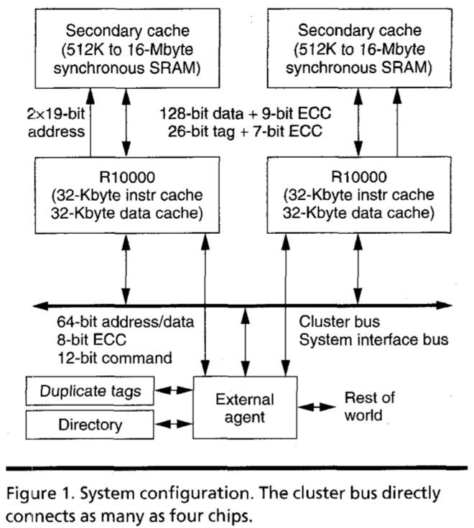
MIPS R10000 Off-Chip L2 Cache (Yeager, IEEE Micro 1996)

Slide 5
Way-Predicting Caches (MIPS R10000 L2 cache)
Use processor address to index into way-prediction table
Look in predicted way at given index, then:
HIT
MISS
Return copy
of data from
cache
Look in other way
Read block of data from
next level of cache
MISS
SLOW HIT
(change entry in prediction table)

Slide 6
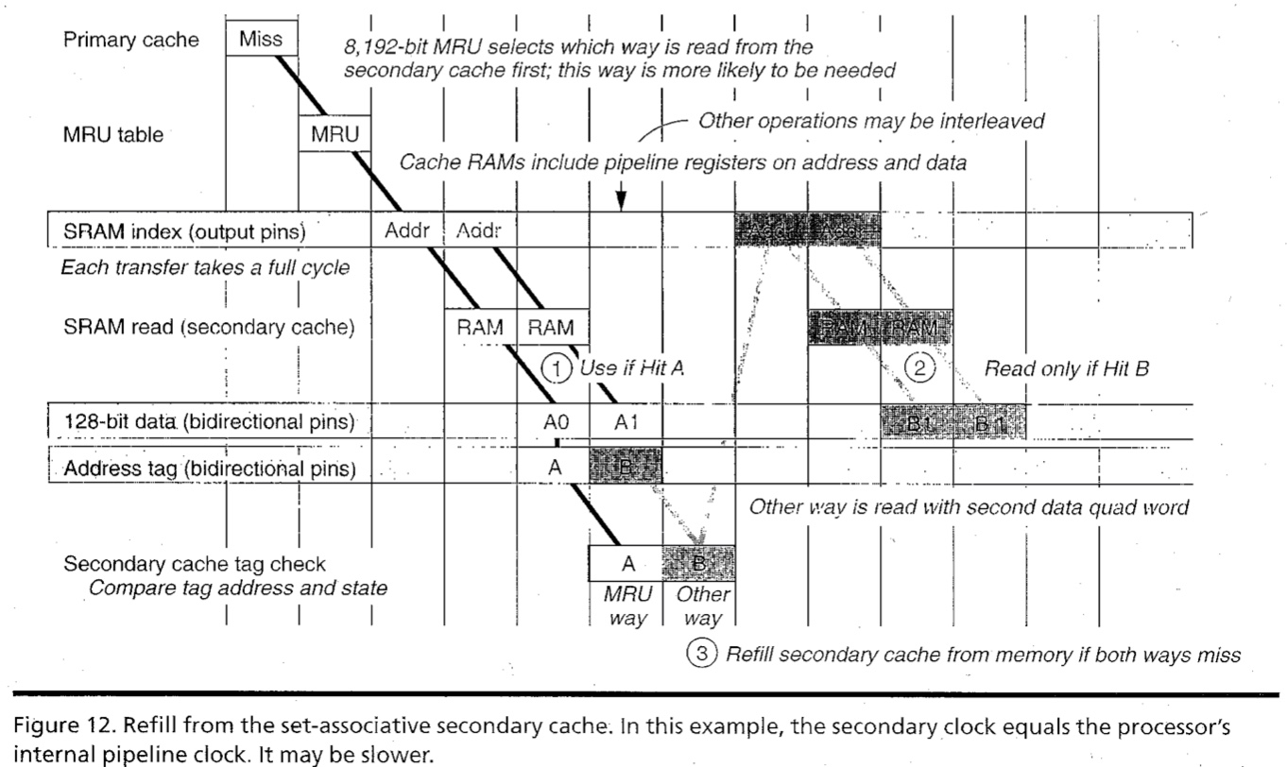
R10000 L2 Cache Timing Diagram

Slide 7
Way-Predicting Instruction Cache (Alpha 21264-like)
Jump target
Store last-used way for sequential path and predicted branch taken path. Can be fetching multiple instructions per cycle.
0x4
Jump control
Add
PC
addr
inst
Primary
Instruction
Cache
way
Sequential Way
Branch Target Way

Slide 8
Reduce Miss Penalty of Long Blocks: Early Restart and Critical Word First
Don’t wait for full block before restarting CPU
Early restart—As soon as the requested word of the block arrives, send it to the CPU and let the CPU continue execution
Critical Word First—Request the missed word first from memory and send it to the CPU as soon as it arrives; let the CPU continue execution while filling the rest of the words in the block
Long blocks more popular today ⇒ Critical Word 1st Widely used
To CPU
To CPU
Word 0
Word 2
Word 1
Word 3
Word 2
Word 0
Rest of line filled in with wrap-around on cache line
Word 3
Word 1

Slide 9
Increasing Cache Bandwidth with Non-Blocking Caches
Non-blocking cache or lockup-free cache allow data cache to continue to supply cache hits during a miss
requires Full/Empty bits on registers or out-of-order execution
“hit under miss” reduces the effective miss penalty by working during miss vs. ignoring CPU requests
“hit under multiple miss” or “miss under miss” may further lower the effective miss penalty by overlapping multiple misses
Significantly increases the complexity of the cache controller as there can be multiple outstanding memory accesses, and can get miss to line with outstanding miss (secondary miss)
Requires pipelined or banked memory system (otherwise cannot support multiple misses)
Pentium Pro allows 4 outstanding memory misses
Cray X1E vector supercomputer allows 2,048 outstanding memory misses

Slide 10
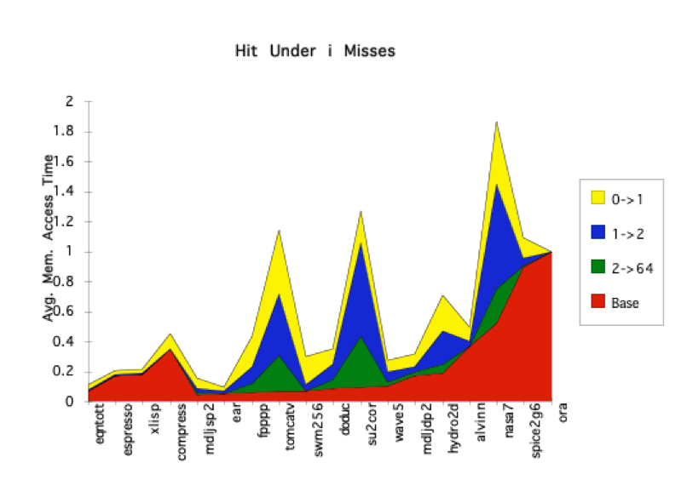
Value of Hit Under Miss for SPEC (old data)
“Hit under n Misses”
Floating Point
0->1
1->2
2->64
Base
Integer
FP programs on average: AMAT= 0.68 -> 0.52 -> 0.34 -> 0.26
Int programs on average: AMAT= 0.24 -> 0.20 -> 0.19 -> 0.19
8 KB Data Cache, Direct Mapped, 32B block, 16 cycle miss, SPEC 92

Slide 11
Address Translation

Slide 12
Bare Machine
PC
Physical Address
D
E
M
Physical Address
W
Inst. Cache
Decode
Data Cache
+
Memory Controller
Physical Address
Physical Address
Physical Address
Main Memory (DRAM)
In a bare machine, the only kind of address is a physical address, corresponding to address lines of actual hardware memory.

Slide 13
Managing Memory in Bare Machines
Early machines only ran one program at a time, with this program having unrestricted access to all memory and all I/O devices
This simple memory management model was also used in turn by the first minicomputer and first microcomputer systems
Subroutine libraries became popular, were written in location-independent form
Different programs use different combination of routines
To run program on bare machines, use linker or loader program to relocate library modules to actual locations in physical memory

Slide 14
Dynamic Address Translation
Motivation
In early machines, I/O was slow and each I/O transfer involved the CPU (programmed I/O)
Higher throughput possible if CPU and I/O of 2 or more programs were overlapped, how?
→ multiprogramming with DMA I/O devices, interrupts
Location-independent programs
Programming and storage management ease
→ need for a base register
Protection
Independent programs should not affect each other inadvertently
→ need for a bound register
Multiprogramming drives requirement for resident supervisor software to manage context switches between multiple programs
Program 1
Physical Memory
Program 2
OS

Slide 15
Simple Base and Bound Translation
Segment Length
Bound
Register
≥
Bounds
Violation?
Logical
Address
Physical
Address
Current
Segment
Physical Memory
Load X
+
Base
Register
Base Physical Address
Program Address Space
Base and bounds registers are visible/accessible only when processor is running in the supervisor mode

Slide 16
Separate Areas for Program and Data
(Scheme used on all Cray vector supercomputers prior to X1, 2002)
Data Bound Register
Bounds Violation?
≥
Logical Address
Data Segment
Load X
Data Base Register
+
Physical Address
Physical Memory
Program Address Space
Program Bound Register
≥
Bounds Violation?
Program Counter
Logical Address
Program Segment
Program Base Register
+
Physical Address
What is an advantage of this separation?
What about more base/bound pairs?
Notes:
Permits sharing of program segments.

Slide 17
Base and Bound Machine
Program Bound Register
Data Bound Register
Bounds Violation?
Bounds Violation?
≥
≥
Logical Address
Logical Address
PC
D
Decode
E
M
W
Inst. Cache
Data Cache
+
+
+
Physical Address
Physical Address
Program Base Register
Data Base Register
Physical Address
Physical Address
Memory Controller
Physical Address
Main Memory (DRAM)
Can fold addition of base register into (register+immediate) address calculation using a carry-save adder (sums three numbers with only a few gate delays more than adding two numbers)

Slide 18
External Fragmentation with Segments
Job 1
32K
Job 1
32K
Job 1
32K
Can’t run Job 4, as not enough contiguous space. Must compact.
Job 2
24K
Job 2
24K
24K
Job 4
32K
72K
Job 3
64K
Job 3
64K
8K
8K
Job 3 starts
Job 2 finishes
Job 4 arrives

Slide 19
CS152 Administrivia
Lab 1 due tonight
Lab 2 out tomorrow (Thursday)
PS2 due on Wednesday Feb 26
Midterm in class time slot Monday March 1
Covers lectures 1 – 9, plus assigned problem sets, labs, book readings
Midterm will use remote zoom proctoring
Need camera on workspace (paper/hands) during exam
Students must show student ID and face at one point during exam
We will contact students needing DSP accommodations directly
Students in remote timezones should contact instructors
Any student with concerns should contact instructors
Dry run in this week and next week’s discussion section
Exam will have randomized questions per student

Slide 20
CS252 Administrivia
Project Proposal due Wednesday Feb 24th
Proposal should be one page PDF including:
Title
Team member names
What are you trying to do?
How is it done today?
What is your idea for improvement and why do you think you’ll be successful
What infrastructure are you going to use for your project?
Project timeline with milestones
Mail PDF of proposal to instructors
Give ~5-minute presentations in class in discussion section time on Thursday March 4th and March 11th

Slide 21
Paged Memory Systems
Program-generated (virtual or logical) address split into:
Page Number
Offset
Page Table contains physical address of start of each fixed-sized page in virtual address space
1
0
0
1
1
0
Physical Memory
Pages
2
2
3
3
Virtual Address Space Pages for Job 1
Page Table
for Job 1
3
2
Paging makes it possible to store a large contiguous virtual memory space using non-contiguous physical memory pages
Notes:
Relaxes the contiguous allocation requirement.

Slide 22
Private Address Space per User
1
0
0
1
1
0
2
2
3
3
1
Virtual Address Space Pages for Job 1
Page Table
for Job 1
3
3
Physical Memory
Pages
3
2
0
0
1
1
2
2
0
3
3
0
Virtual Address Space Pages for Job 2
Page Table
for Job 2
2
2
0
0
1
1
1
2
2
3
3
Operating
Virtual Address Space Pages for Job 3
Page Table
for Job 3
System
Pages
Notes:
Relaxes the contiguous allocation requirement.

Slide 23
Paging Simplifies Allocation
Fixed-size pages can be kept on OS free list and allocated as needed to any process
Process memory usage can easily grow and shrink dynamically
Paging suffers from internal fragmentation where not all bytes on a page are used
Much less of an issue than external fragmentation or compaction for common page sizes (4-8KB)
But one reason that many oppose move to larger page sizes

Slide 24
Page Tables Live in Memory
Physical Memory
Pages
1
0
Simple linear page tables are too large, so hierarchical page tables are commonly used (see later)
1
3
3
0
1
2
2
3
0
Virtual Address Space Pages for Job 2
2
Common for modern OS to place page tables in kernel’s virtual memory (page tables can be swapped to secondary storage)
0
Page Table
1
for Job 2
2
3
Virtual Address Space Pages for Job 1
Page Table
for Job 1
Notes:
Relaxes the contiguous allocation requirement.

Slide 25
Coping with Limited Primary Storage
Paging reduces fragmentation, but still many problems would not fit into primary memory, have to copy data to and from secondary storage (drum, disk)
Two early approaches:
Manual overlays, programmer explicitly copies code and data in and out of primary memory
Tedious coding, error-prone (jumping to non-resident code?)
Software interpretive coding (Brooker 1960). Dynamic interpreter detects variables that are swapped out to drum and brings them back in
Simple for programmer, but inefficient
Not just ancient black art, e.g., IBM Cell microprocessor using in Playstation-3 had explicitly managed local store!
Many new “deep learning” accelerators have similar structure.

Slide 26
Demand Paging in Atlas (1962)
“A page from secondary
storage is brought into the primary storage whenever it is (implicitly) demanded by the processor.”
Tom Kilburn
Primary
32 Pages
512 words/page
Primary memory as a cache
for secondary memory
Secondary
(Drum)
32x6 pages
Central
Memory
User sees 32 x 6 x 512 words
of storage
Notes:
Single-level Store

Slide 27
Hardware Organization of Atlas
Effective
Address
16 ROM pages
0.4-1 μsec
system code
(not swapped)
system data
(not swapped)
Initial
Address
Decode
2 subsidiary pages
1.4 μsec
PARs
48-bit words
512-word pages
1 Page Address Register (PAR) per page frame
0
Main
32 pages
1.4 μsec
Drum (4)
192 pages
8 Tape decks
88 sec/word
31
<effective PN , status>
Compare the effective page address against all 32 PARs
match ⇒ normal access
no match ⇒ page fault
save the state of the partially executed instruction

Slide 28
Atlas Demand-Paging Scheme
On a page fault:
Input transfer into a free page is initiated
The Page Address Register (PAR) is updated
If no free page is left, a page is selected to be replaced (based on usage)
The replaced page is written on the drum
to minimize drum latency effect, the first empty page on the drum was selected
The page table is updated to point to the new location of the page on the drum

Slide 29
Size of Linear Page Table
With 32-bit addresses, 4-KB pages & 4-byte PTEs:
220 PTEs, i.e, 4 MB page table per user
4 GB of swap needed to back up full virtual address space
Larger pages?
Internal fragmentation (Not all memory in page is used)
Larger page fault penalty (more time to read from disk)
What about 64-bit virtual address space???
Even 1MB pages would require 244 8-byte PTEs (35 TB!)
What is the “saving grace” ?
Notes:
Virtual address space is large but only a small fraction of the
pages are populated. So we can use a sparse representation
of the table.

Slide 30
Hierarchical Page Table
Data Pages
Virtual Address from CPU
31
22
21
12
11
0
p1 p2 offset
10-bit
L1 index
10-bit
L2 index
offset
Root of Current
Page Table
p2
p1
Physical Memory
(Processor
Register, satp in RISC-V)
Level 1
Page Table
Level 2
Page Tables
page in primary memory
page in secondary memory
PTE of a nonexistent page
RISC-V Sv32 Virtual Memory Scheme

Slide 31
Two-Level Page Tables in Physical Memory
Physical Memory
Virtual Address Spaces
Level 1 PT User 1
VA1
Level 1 PT User 2
User 1
User2/VA1
VA1
User1/VA1
User 2
Level 2 PT User 2

Slide 32
Address Translation & Protection
Virtual Address
Virtual Page No. (VPN)
offset
Supervisor/User Mode
Read/Write
Protection Check
Address
Translation
Exception?
Physical Page No. (PPN)
offset
Physical Address
Every instruction and data access needs address
translation and protection checks
A good VM design needs to be fast (~ one cycle) and space efficient

Slide 33
Translation-Lookaside Buffers (TLB)
Address translation is very expensive!
In a two-level page table, each reference becomes several memory accesses
Solution: Cache translations in TLB
TLB hit ⇒ Single-Cycle Translation
TLB miss ⇒ Page-Table Walk to refill
virtual address
VPN offset
V R W D tag PPN
(VPN = virtual page number)
(PPN = physical page number)
hit?
physical address
PPN offset
Notes:
3 memory references
2 page faults (disk accesses) + ..
Actually used in IBM before paged memory.

Slide 34
TLB Designs
Typically 32-128 entries, usually fully associative
Each entry maps a large page, hence less spatial locality across pages ➔ more likely that two entries conflict
Sometimes larger TLBs (256-512 entries) are 4-8 way set-associative
Larger systems sometimes have multi-level (L1 and L2) TLBs
Random or FIFO replacement policy
TLB Reach: Size of largest virtual address space that can be simultaneously mapped by TLB
Example: 64 TLB entries, 4KB pages, one page per entry
TLB Reach = _____________________________________________?
64 entries * 4 KB = 256 KB (if contiguous)

Slide 35
Handling a TLB Miss
Software (MIPS, Alpha)
TLB miss causes an exception and the operating system walks the page tables and reloads TLB. A privileged “untranslated” addressing mode used for walk.
Software TLB miss can be very expensive on out-of-order superscalar processor as requires a flush of pipeline to jump to trap handler.
Hardware (SPARC v8, x86, PowerPC, RISC-V)
A memory management unit (MMU) walks the page tables and reloads the TLB.
If a missing (data or PT) page is encountered during the TLB reloading, MMU gives up and signals a Page Fault exception for the original instruction.
NOTE: A given ISA can use either TLB miss strategy

Slide 36
Hierarchical Page Table Walk: SPARC v8
Virtual Address
Index 1 Index 2 Index 3 Offset
31 23 17 11 0
Context
Table
Register
Context Table
L1 Table
root ptr
Context
Register
L2 Table
PTP
L3 Table
PTP
PTE
31 11 0
Physical Address
PPN Offset
MMU does this table walk in hardware on a TLB miss

Slide 37
Page-Based Virtual-Memory Machine (Hardware Page-Table Walk)
Page Fault?
Protection violation?
Page Fault?
Protection violation?
Virtual Address
Virtual Address
Physical Address
Physical Address
PC
Inst. TLB
D
Decode
E
M
Data TLB
W
Inst. Cache
Data Cache
+
Miss?
Miss?
Page-Table Base Register
Hardware Page Table Walker
Physical Address
Memory Controller
Physical Address
Physical Address
Main Memory (DRAM)
Assumes page tables held in untranslated physical memory

Slide 38
Page-Fault Handler
When the referenced page is not in DRAM:
The missing page is located (or created)
It is brought in from disk, and page table is updated
Another job may be run on the CPU while the first job waits for the requested page to be read from disk
If no free pages are left, a page is swapped out
Pseudo-LRU replacement policy, implemented in software
Since it takes a long time to transfer a page (msecs), page faults are handled completely in software by OS
Untranslated addressing mode is essential to allow kernel to access page tables
Keeping TLBs coherent with page table changes might require expensive “TLB shootdown”
Interrupt other processors to invalidate stale TLB entries
Some mainframes had hardware TLB coherence

Slide 39
Handling VM-related exceptions
PC
Inst TLB
Inst. Cache
D
Decode
E
M
Data TLB
Data Cache
W
+
TLB miss? Page Fault?
Protection violation?
TLB miss? Page Fault?
Protection violation?
Handling a TLB miss needs a hardware or software mechanism to refill TLB
Handling page fault (e.g., page is on disk) needs restartable exception so software handler can resume after retrieving page
Precise exceptions are easy to restart
Can be imprecise but restartable, but this complicates OS software
A protection violation may abort process
But often handled the same as a page fault

Slide 40
Acknowledgements
This course is partly inspired by previous MIT 6.823 and Berkeley CS252 computer architecture courses created by my collaborators and colleagues:
Arvind (MIT)
Joel Emer (Intel/MIT)
James Hoe (CMU)
John Kubiatowicz (UCB)
David Patterson (UCB)

